Slide 1
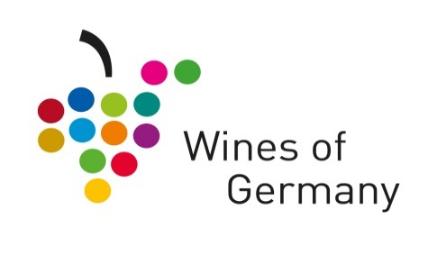
Get involved!
Saturday 1st – Monday 31st July 2023
What’s it all about?
A month-long summer promotion, organised by Wines of Germany, which runs throughout July. We'll be working with independent merchants and retailers, as well as wine bars and restaurants up and down the country to celebrate Germany’s star variety, Riesling.
Why?
For the wine trade, July has become synonymous with Riesling and we want to keep building this to generate a real buzz around Germany’s most exciting and versatile grape. We’re keen to enlist as many new outlets as possible and to welcome back previous participants to spread the word.
What’s in it for you?
Support with hosting your very own launch party: £75 grants for samples
£1000 towards new German listings for the winning campaign
£500 towards new German listings for the runner up
Digital assets and eye-catching POS for you to use in your shops, online and on social media to advertise your involvement
Our POS packs will include tote bags, tissue paper, window stickers and new posters (whilst stock lasts).
Promotion and support on social media and the Wines of Germany website for your activities, including features on the events page of our new consumer hub.
How can you take part?
You know your customers better than we do, so it’s up to you how you promote German Riesling during the month.
The only requirements are that you offer German Riesling from at least three German producers, two of which must be dry, and that you carry out the promotion for at least one week during the month of July.
New for this year, we would love for you to show how German wines are the perfect #FridgeDoorWines to reach for this summer, by taking part in our “Fridge Door Takeover” competition. Win a case of German white wines for the most inventive, extensive fridge display!
Here are a few more of our favourite ideas from previous participants:
Weekly drop-in tastings
In-store displays
Virtual or in person winemaker tastings
In-store, online and social media competitions
German Riesling mixed cases
To note, judging will take into account the use of social media, newsletters, blog posts, displays and promotions, the number of German producers used and sales uplift over July. So, get creative!
Launch party funding
Following feedback from participants who want to host more events, we want to support you in hosting your own launch party within the first week of July!
We will be offering participants up to £75 to fund samples. To receive funding, all we ask is that you share your launch event on social media with the hashtags #31daysofgermanriesling and #31DaysLaunchParty.
This funding is available to the first 25 sign ups.

Slide 2
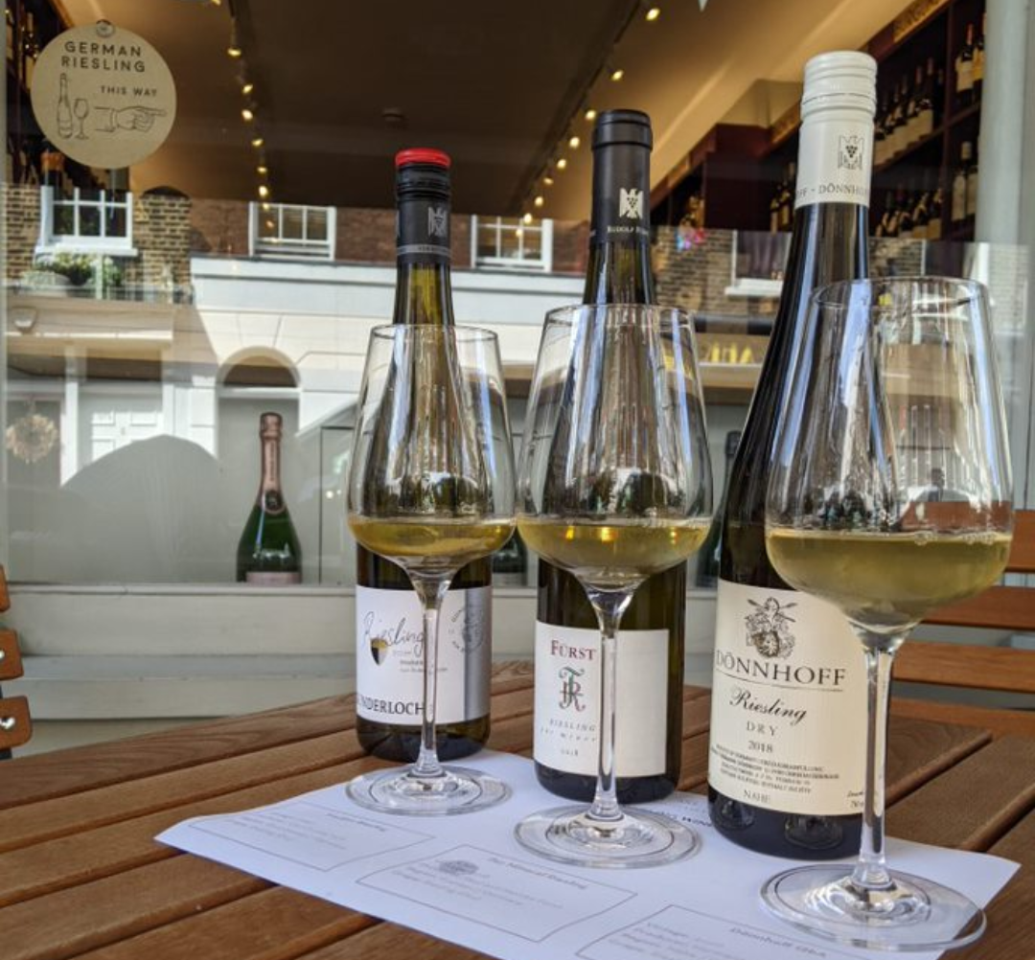
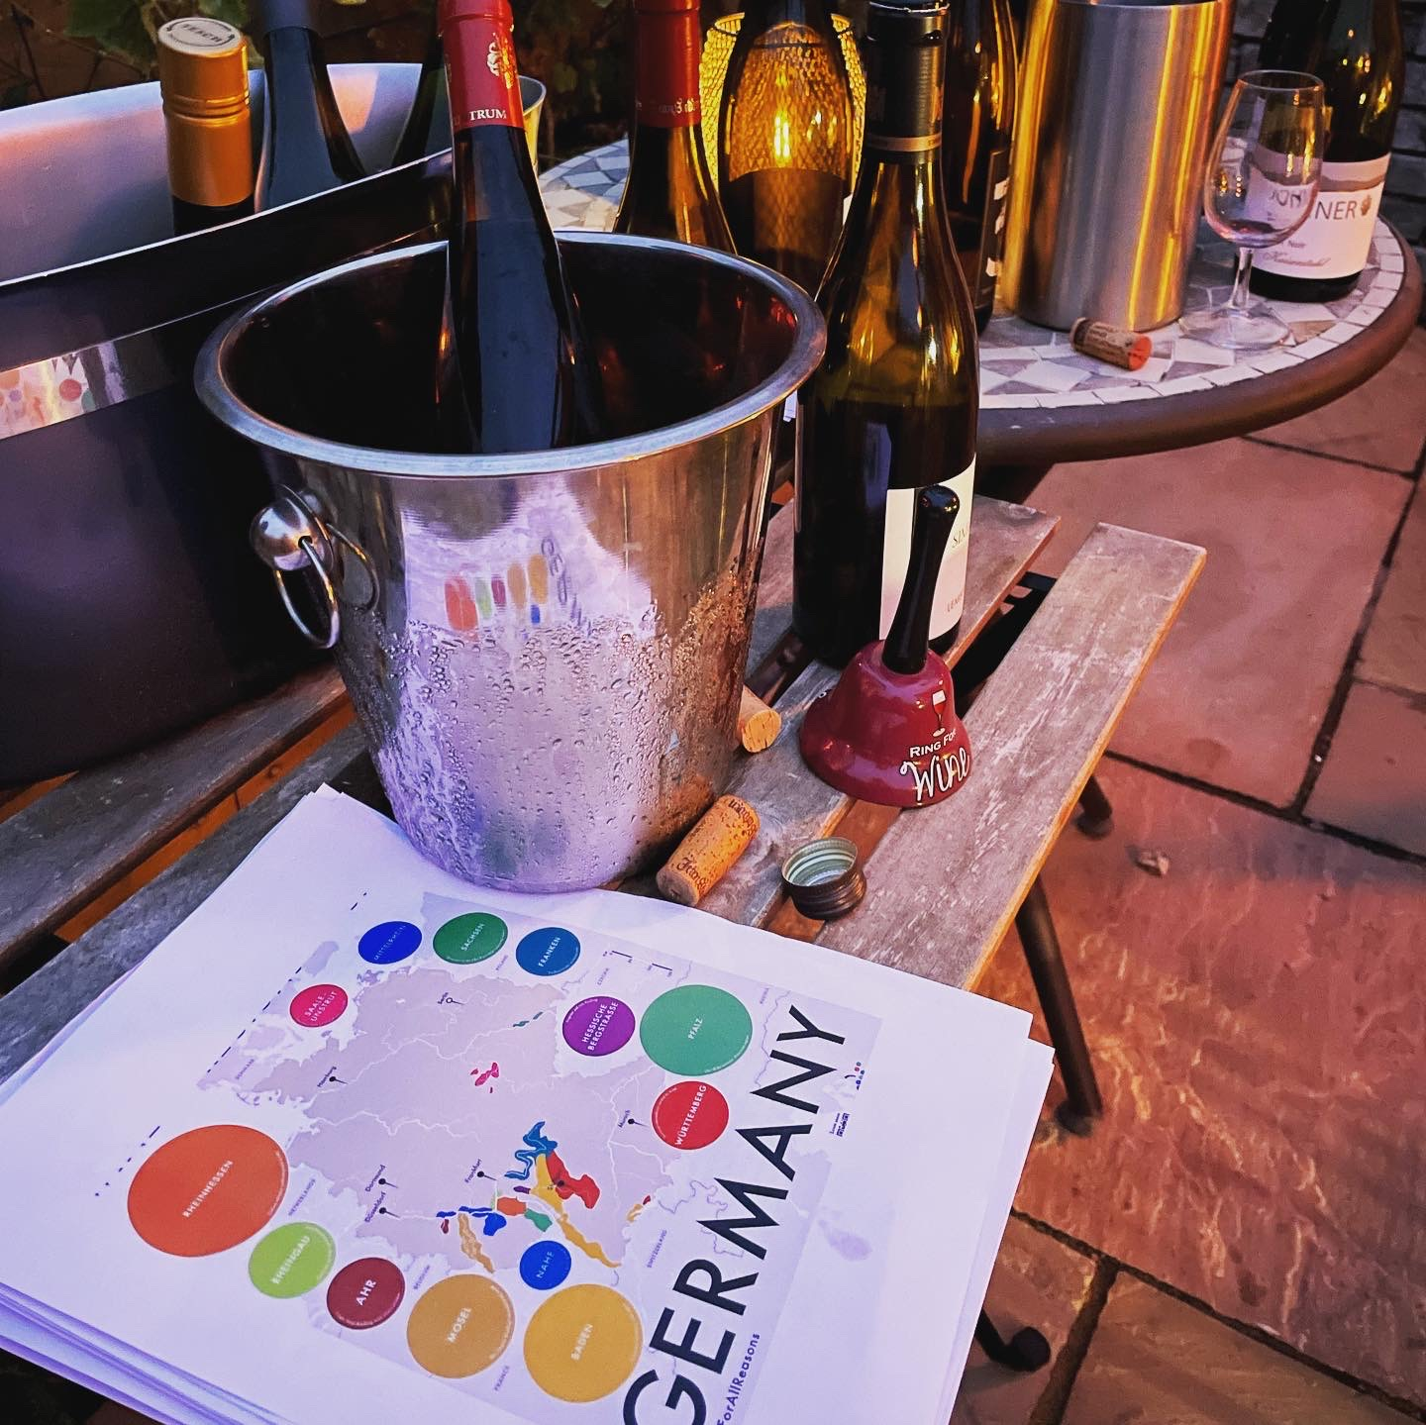
How do you register?
Please register by completing this form by Friday 31st May 2024 to secure a POS pack.
If you have any questions at all, please contact germanwine@thisisphipps.com.
Once registered, we’ll be in touch to request further information on your activities, and with details of POS materials.
How will we help?
Cash support will be given for retailers to host their own launch parties, provided conditions are adhered to.
You will be able to download materials on the Wines of Germany website (at a later date) to help run your own events. We have also refreshed our branded POS packs with new materials to set the scene!
Send us details about your events and promotions and these will be featured on our consumer hub 31days.winesofgermany.co.uk to help drive consumers through your doors.
Social media, as ever, will play a huge role – use the #31DaysofGermanRiesling and #31DaysLaunchParty (if you'll be joining us in throwing a launch party) and tag @winesofgermanyuk when posting and your content will be shared on our channels too!

